Slide 1
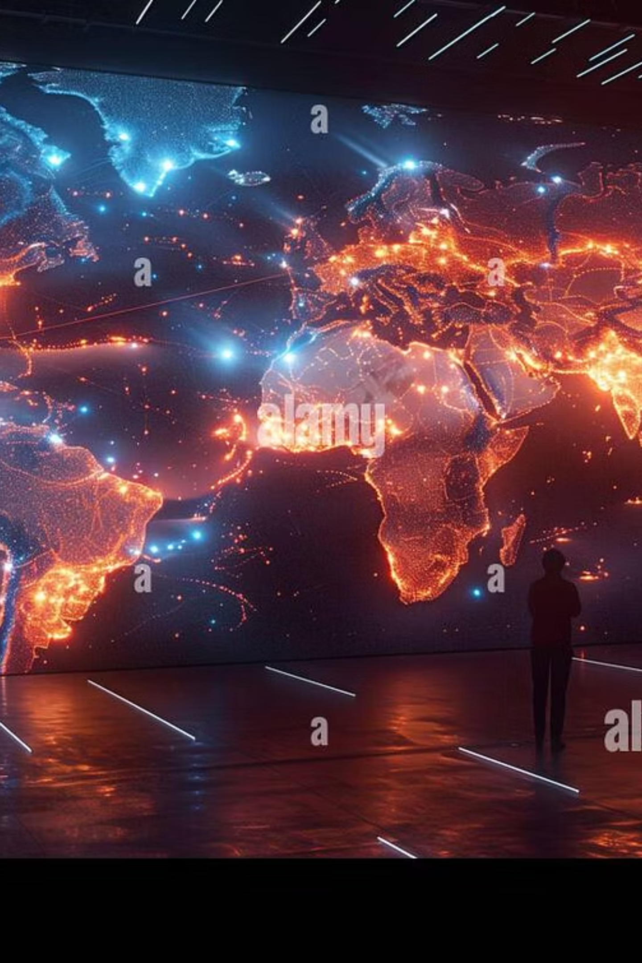
Travel Tuner: AI-Powered Travel Planning Platform
Guide Name: Yogasambhuta Dash

Slide 2
Project Statement & Motivation
Problem:
People waste a lot of time searching on many websites for hotels, routes, and attractions.
Planning for family or group trips becomes confusing.
Travelers sometimes miss good places because of poor planning.
Motivation:
To give one single platform for full travel planning.
To make planning fast, smart, and less stressful.
To use AI so even first-time travelers can plan like experts.

Slide 3
Objectives
1
AI-Powered Personalization
2
Interactive Exploration
3
Real-time Collaboration
Make smart plans for each user by using their likes, choices, and past travel data.
Let users explore destinations with maps, photos, and easy-to-use design the route.
To allow groups like friends and family to plan trips together at the same time.
4
Seamless Integration
5
Engaging User Experience
Give booking links and live suggestions (hotels, travel, food) in one place.
Make the system simple, fun, and smooth—like popular apps (TripIt, Wanderlog, Roadtrippers).

Slide 4

Project Functionalities / Features
AI-Powered Itinerary Generator: Creates optimized, customizable travel plans tailored to user inputs and preferences.
Group Collaboration: Share and co-edit itineraries with friends in real-time for group trips.
Smart Recommendations: AI suggests dining, activities, and lodging with integrated booking links.
Destination Discovery: Explore places with rich media, reviews, and AI-curated recommendations.
Interactive Maps: Visualize attractions, accommodations, and routes dynamically on maps.
User-Friendly Interface: Drag-and-drop itinerary editing, calendar views, and export options.

Slide 5




Methodology / Architecture
User Input
AI Processing
Data Integration
Travel Plan Output
Our architecture is built on a modular design. The User Input Layer collects preferences. This feeds into the AI Engine, which uses NLP and machine learning for personalization. Data Integration pulls from various travel APIs. The Collaboration Module ensures real-time syncing for groups. All these layers culminate in a responsive UI/UX Layer providing an intuitive interface and exportable trip plans.

Slide 6


Challenges & Solutions
1: We faced issues with AI information and ensuring up-to-date data from various sources, requiring iterative tuning and API enhancements, Limited travel data and hotel options, Slow map loading at times.
2.We faced version mis-match issue of AUTH0 platform with Mongo client.
3. During fetching AI API were getting either paid or very limited request API also Faced compatible Issue.
4:During payment integration they are asking for verifying business PAN number.
.
Solutions:
1:Used free APIs to get more data. Started using AI to give better suggestion This approach maintains accuracy and builds user trust, ensuring the platform remains reliable and practical.
2:The Problems were solved by GEMINI 2.5 FLASH“ model. It is free and more free request.
Our iterative development process allowed for rapid prototyping and user-centric improvements.

Slide 7




Conclusion & Future Work
Travel Tuner demonstrates how AI and collaboration can fundamentally transform travel planning by simplifying complex tasks and significantly enhancing user engagement.
Deeper Integration
Global Reach
Seamlessly link with booking platforms for flights, hotels, and activities, enabling one-click reservations.
Implement multilingual support to serve a diverse international user base.
Dynamic Adjustments
Enriched Experience
Integrate AI-driven real-time trip adjustments based on weather, local events, or user preferences during travel.
Incorporate social sharing features and personalized travel journals to further enhance the user journey.
Vision: Our goal is to become the ultimate AI travel companion that makes every trip effortless, personalized, and truly memorable.

